Slide 1
COMPUTER GRAPHICS AND MULTIMEDIA
CS3CO24

Slide 2
Unit 4
Curve Generation, Bezier and B-spline Methods. Basic Illumination Model: Diffuse Reflection, Specular Reflection, Phong Shading, Gouraud Shading, Ray Tracing, Color Models like RGB, YIQ, CMY, HSV.

Slide 3
CURVE GENERATION
We often need to draw different types of objects onto the screen. Objects are not flat all the time and we need to draw curves many times to draw an object.

Slide 4
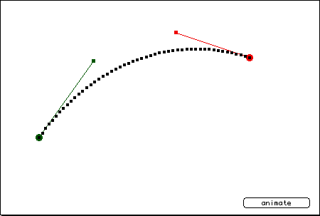
Curve
A curve is an infinitely large set of points. Each point has two neighbors except endpoints in specific direction.

Slide 5
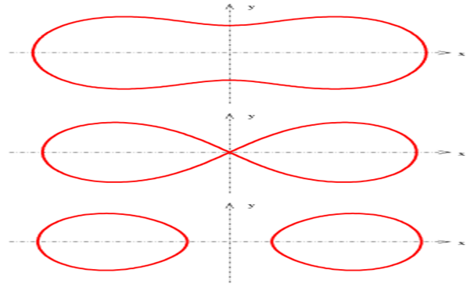
Types of curve
Implicit Curves
An implicit function is used to define the implicit curve
f(x, y) = 0

Slide 6
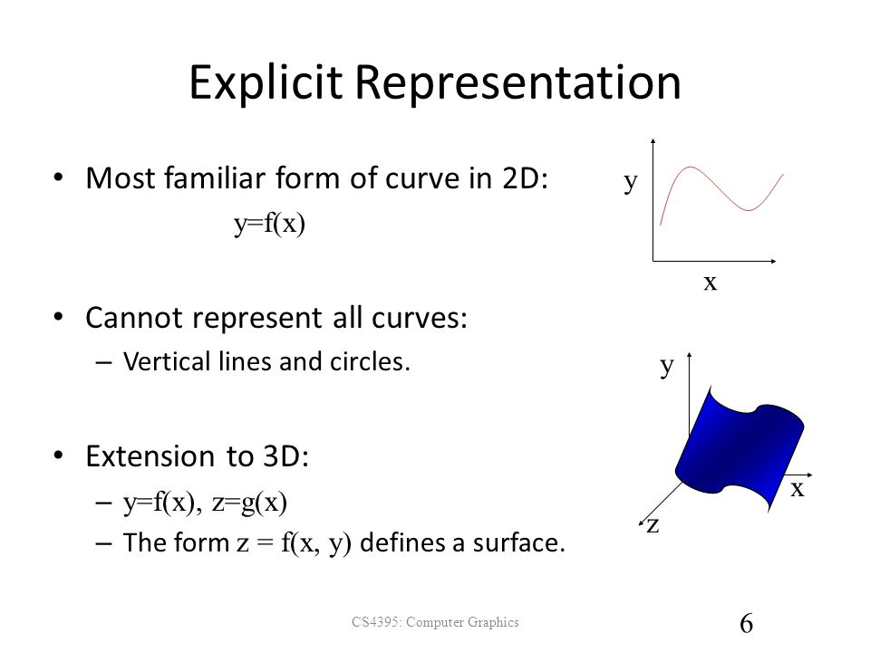
Types of curve Cont.…
2. Explicit Curves:-
An explicit function is used to define the explicit curve
y = f(x)

Slide 7
Types of curve cont.…
3. Parametric Curves:- Parametric curves are the curves which have parametric values. Practically parametric curves are mostly used. The form of a two-dimensional parametric curve is:
P(t) = f(t), g(t)
or
P(t) = x(t), y(t)
The functions f and g become the (x, y) coordinates of any point on the curve, and the points are obtained when the parameter t is varied over a certain interval [a, b], normally [0, 1].

Slide 8
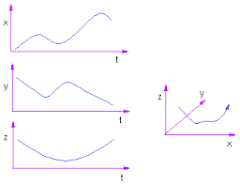
Parametric curve

Slide 9
Bezier curves
Bezier Curve is parametric curve defined by a set of control points.
Two points are ends of the curve.
Other points determine the shape of the curve.
The concept of Bezier curves was given by Pierre Bezier.

Slide 10
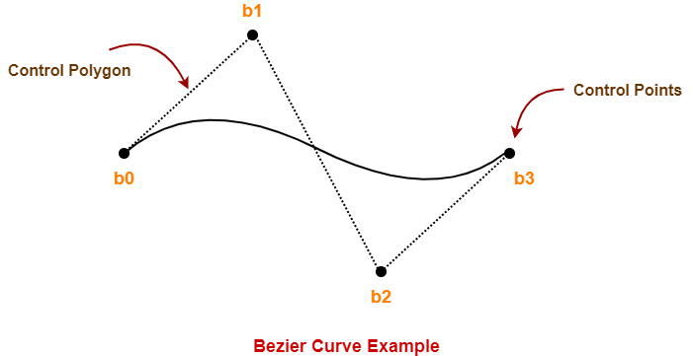
Bezier curve
This Bezier curve is defined by a set of control points b₀, b₁, b₂ and b₃.
Points b₀ and b₃ are ends of the curve.
Points b₁ and b₂ determine the shape of the curve.

Slide 11
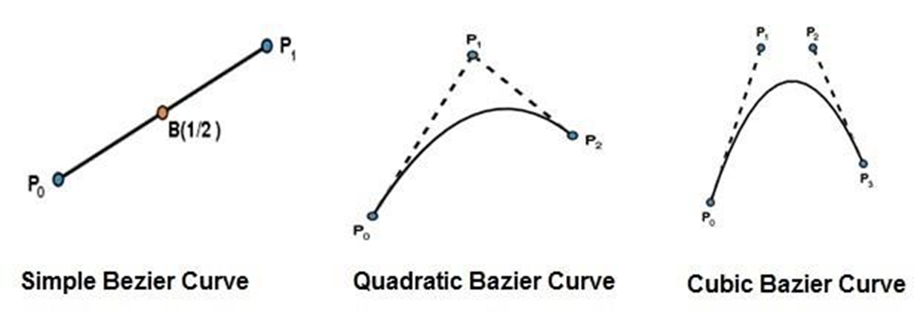
Types of bezier curve
The simplest Bezier curve is the straight line from the point P0 to P1.
A quadratic Bezier curve is determined by three control points.
A cubic Bezier curve is determined by four control points.

Slide 12
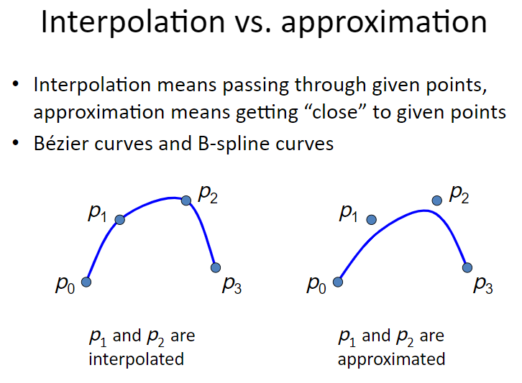

Slide 13
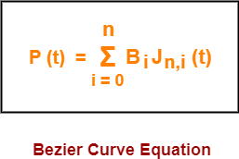
Bezier Curve Equation-
A bezier curve is parametrically represented by-
t is any parameter where 0 <= t <= 1
P(t) = Any point lying on the bezier curve
B_{i} = i^{th} control point of the bezier curve
n = degree of the curve
J_{n,i}(t) = Blending function = C(n,i)t^{i}(1-t)^{n-i} where C(n,i) = n! / i!(n-i)!

Slide 14
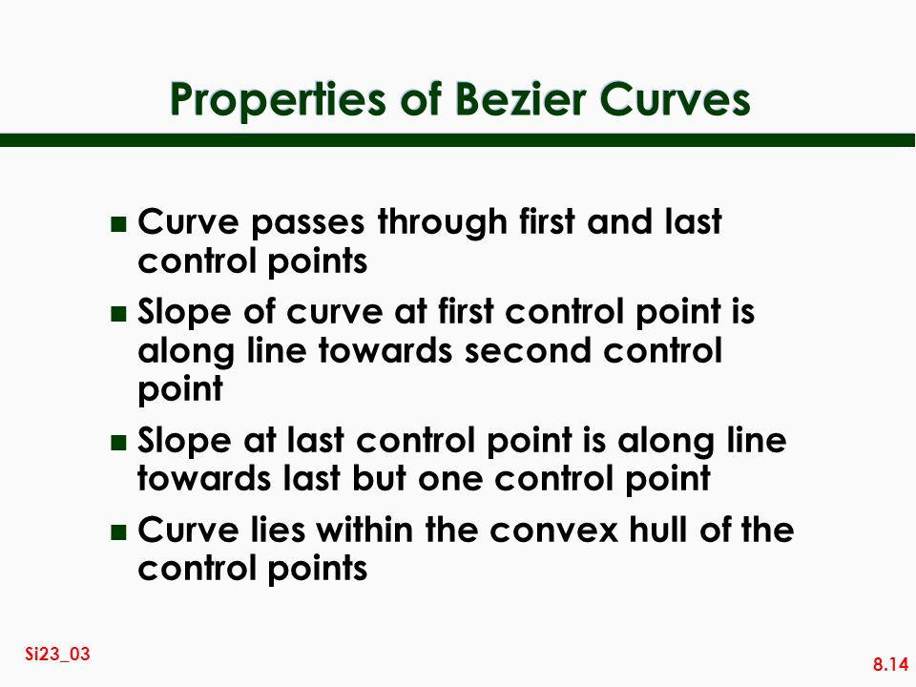

Slide 15
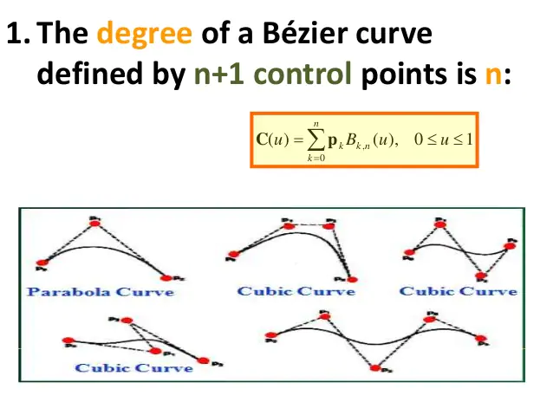
Bezier Curve Properties-

Slide 16
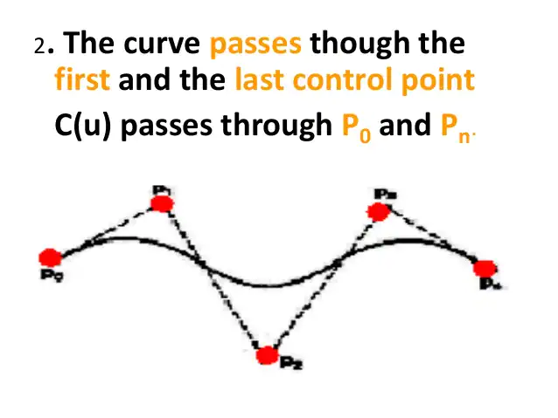
Bezier Curve Properties-

Slide 17
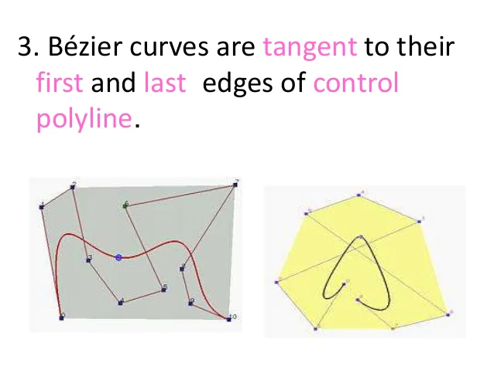
Bezier Curve Properties-

Slide 18
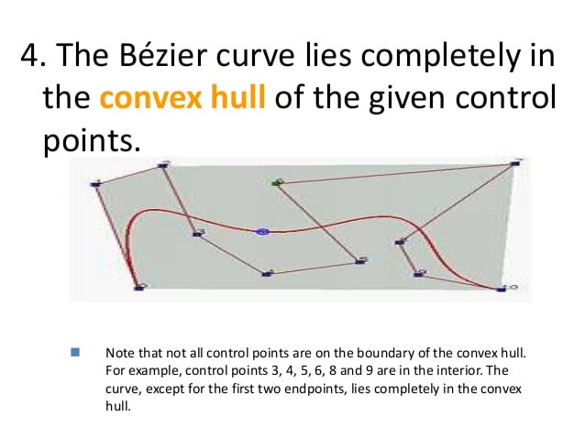
Bezier Curve Properties-
Order = Number of Control Points

Slide 19
Given a bezier curve with 4 control points- B₀[1 0] , B₁[3 3] , B₂[6 3] , B₃[8 1] Determine any 5 points lying on the curve. Also, draw a rough sketch of the curve.

Slide 20
We have- The given curve is defined by 4 control points. So, the given curve is a cubic bezier curve. The parametric equation for a cubic bezier curve is- P(t) = B₀(1-t)³ + B₁3t(1-t)² + B₂3t²(1-t) + B₃t³

Slide 21
Substituting the control points B₀, B₁, B₂ and B₃, we get- P(t) = [1 0](1-t)³ + [3 3]3t(1-t)² + [6 3]3t²(1-t) + [8 1]t³ ……..(1) Now, To get 5 points lying on the curve, assume any 5 values of t lying in the range 0 <= t <= 1. Let 5 values of t are 0, 0.2, 0.5, 0.7, 1

Slide 22
For t = 0: Substituting t=0 in (1), we get- P(0) = [1 0](1-0)³ + [3 3]3(0)(1-0)² + [6 3]3(0)²(1-0) + [8 1](0)³ P(0) = [1 0] + 0 + 0 + 0 P(0) = [1 0]

Slide 23
For t = 0.2: Substituting t=0.2 in (1), we get- P(0.2) = [1 0](1-0.2)³ + [3 3]3(0.2)(1-0.2)² + [6 3]3(0.2)²(1-0.2) + [8 1](0.2)³ P(0.2) = [1 0](0.8)³ + [3 3]3(0.2)(0.8)² + [6 3]3(0.2)²(0.8) + [8 1](0.2)³ P(0.2) = [1 0] x 0.512 + [3 3] x 3 x 0.2 x 0.64 + [6 3] x 3 x 0.04 x 0.8 + [8 1] x 0.008 P(0.2) = [1 0] x 0.512 + [3 3] x 0.384 + [6 3] x 0.096 + [8 1] x 0.008 P(0.2) = [0.512 0] + [1.152 1.152] + [0.576 0.288] + [0.064 0.008] P(0.2) = [2.304 1.448]

Slide 24
For t = 0.5: Substituting t=0.5 in (1), we get- P(0.5) = [1 0](1-0.5)³ + [3 3]3(0.5)(1-0.5)² + [6 3]3(0.5)²(1-0.5) + [8 1](0.5)³ P(0.5) = [1 0](0.5)³ + [3 3]3(0.5)(0.5)² + [6 3]3(0.5)²(0.5) + [8 1](0.5)³ P(0.5) = [1 0] x 0.125 + [3 3] x 3 x 0.5 x 0.25 + [6 3] x 3 x 0.25 x 0.5 + [8 1] x 0.125 P(0.5) = [1 0] x 0.125 + [3 3] x 0.375 + [6 3] x 0.375 + [8 1] x 0.125 P(0.5) = [0.125 0] + [1.125 1.125] + [2.25 1.125] + [1 0.125] P(0.5) = [4.5 2.375]

Slide 25
For t = 0.7: Substituting t=0.7 in (1), we get- P(t) = [1 0](1-t)³ + [3 3]3t(1-t)² + [6 3]3t²(1-t) + [8 1]t³ P(0.7) = [1 0](1-0.7)³ + [3 3]3(0.7)(1-0.7)² + [6 3]3(0.7)²(1-0.7) + [8 1](0.7)³ P(0.7) = [1 0](0.3)³ + [3 3]3(0.7)(0.3)² + [6 3]3(0.7)²(0.3) + [8 1](0.7)³ P(0.7) = [1 0] x 0.027 + [3 3] x 3 x 0.7 x 0.09 + [6 3] x 3 x 0.49 x 0.3 + [8 1] x 0.343 P(0.7) = [1 0] x 0.027 + [3 3] x 0.189 + [6 3] x 0.441 + [8 1] x 0.343 P(0.7) = [0.027 0] + [0.567 0.567] + [2.646 1.323] + [2.744 0.343] P(0.7) = [5.984 2.233]

Slide 26
For t = 1: Substituting t=1 in (1), we get- P(1) = [1 0](1-1)³ + [3 3]3(1)(1-1)² + [6 3]3(1)²(1-1) + [8 1](1)³ P(1) = [1 0] x 0 + [3 3] x 3 x 1 x 0 + [6 3] x 3 x 1 x 0 + [8 1] x 1 P(1) = 0 + 0 + 0 + [8 1] P(1) = [8 1]

Slide 27
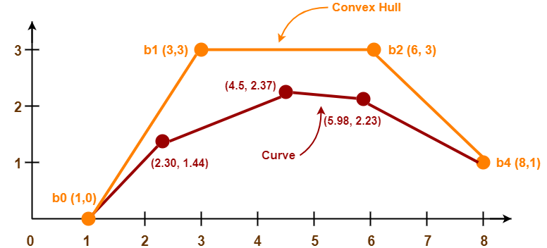

Slide 28
Applications of Bezier Curves-
1. Computer Graphics-
Bezier curves are widely used in computer graphics to model smooth curves.
The curve is completely contained in the convex hull of its control points.
So, the points can be graphically displayed & used to manipulate the curve intuitively.

Slide 29
Applications of Bezier Curves-
2. Animation-
Bezier curves are used to outline movement in animation applications such as Adobe Flash and synfig.
Users outline the wanted path in bezier curves.
The application creates the needed frames for the object to move along the path.
For 3D animation, bezier curves are often used to define 3D paths as well as 2D curves.

Slide 30
Applications of Bezier Curves-
3. Fonts-
True type fonts use composite bezier curves composed of quadratic bezier curves.
Modern imaging systems like postscript, asymptote etc use composite bezier curves composed of cubic bezier curves for drawing curved shapes.

Slide 31
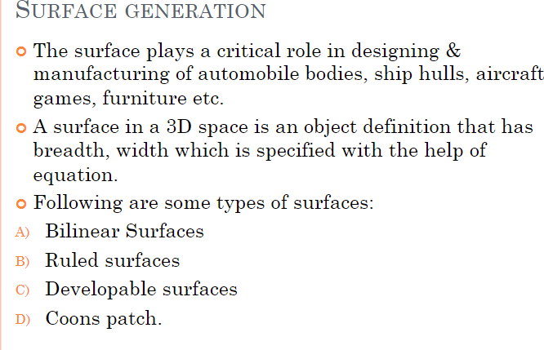

Slide 32
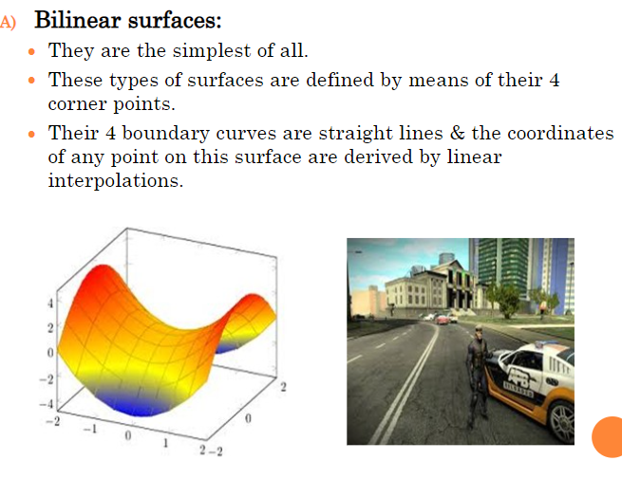
surface generation

Slide 33
Surface generation

Slide 34
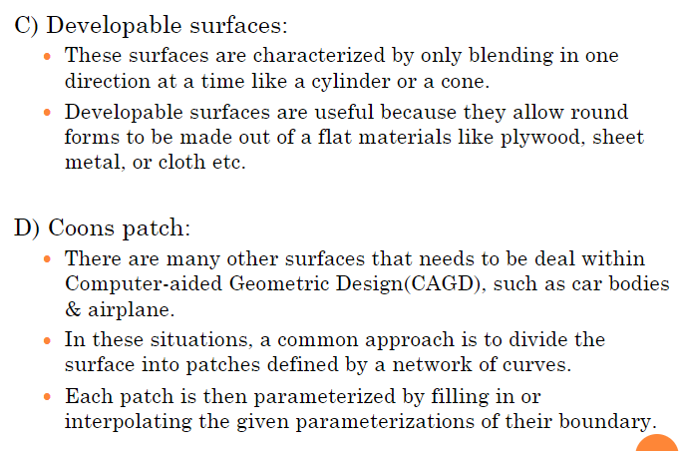
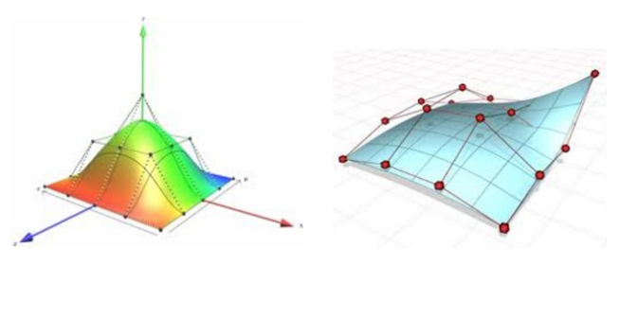
Surface generation

Slide 35
Surface generation

Slide 36
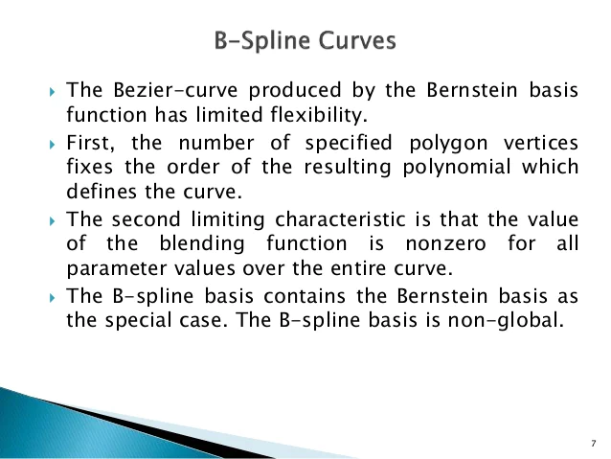

Slide 37
B-Spline Curves (Two Advantages)
The degree of a B-spline polynmial can be set independently of the number of control points.
B-splines allow local control over the shape of a spline curve (or surface)

Slide 38
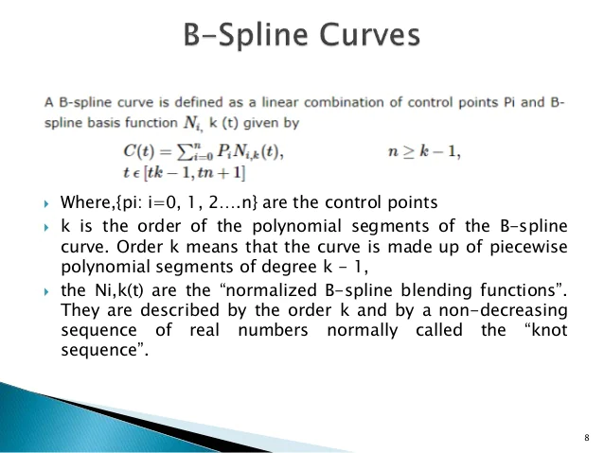

Slide 39
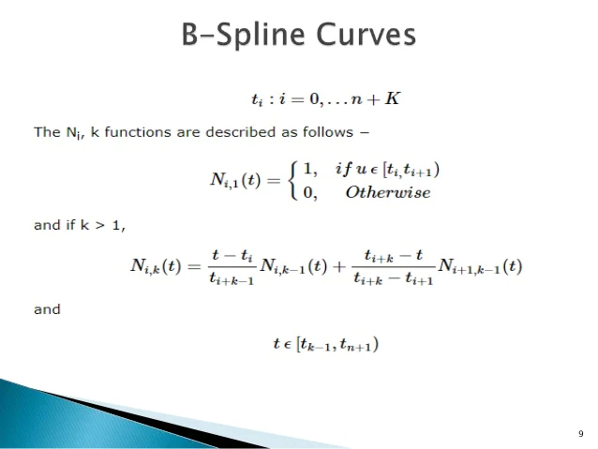

Slide 40
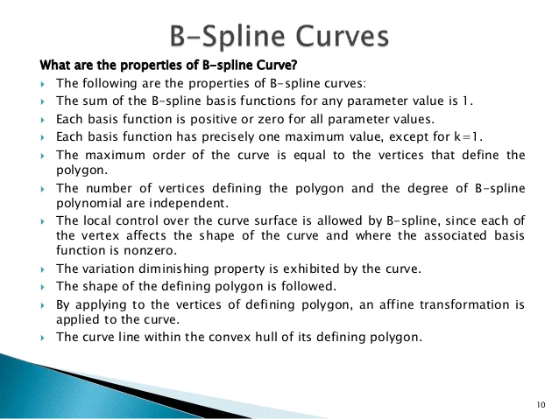

Slide 41
Unit 4
Curve Generation, Bezier and B-spline Methods. Basic Illumination Model: Diffuse Reflection, Specular Reflection, Phong Shading, Gouraud Shading, Ray Tracing, Color Models like RGB, YIQ, CMY, HSV.

Slide 42
Illumination Models and Shading
Diffuse Reflection
Specular Reflection
Phong shading
Gouraud Shading
Ray Tracing

Slide 43
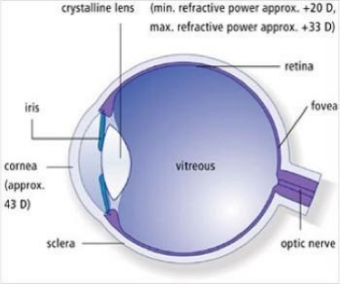
Background of illumination
The eye works like a camera
Sensors at the back of eye
Sense the amount of light coming from different directions

Slide 44
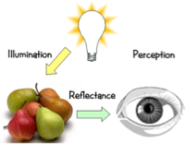
Light coming into the eye
Position of the point the eye is looking at
Position of the light source
Colour and intensity of light
Vector from eye to point
Normal vector of surface at point
Physical properties of the object

Slide 45




Illumination Models
Light energy falling on a surface can be:
reflected light
heat
Absorbed
Reflected
Transmitted
absorbed
light (heat)
They make an object visible
transmitted light
The amount of energy absorbed, transmitted or deflected depends on the
wavelength (w.l.) of the light.

Slide 46
Illumination Models
The character of the light reflected or transmitted... depends on:
Composition of the light surface source
The surface orientation
The surface properties of the object
Direction of the light source
Geometry of the light source

Slide 47
Illumination Models
Motivation: In order to produce realistic images, we must simulate the appearance of surfaces under various lighting conditions
Illumination Model: Given the illumination incident at a point on a surface, quantifies the reflected light

Slide 48
Illumination Models and Rendering
An illumination model is used to calculate the intensity of the light that is reflected at a given point on a surface
A rendering method uses intensity calculations from the illumination model to determine the light intensity at all pixels in the image

Slide 49
Illumination Model Parameters
Lighting effects are described with models that consider the interaction of light sources with object surfaces
The factors determining the lighting effects are:
light source: The wavelength of light is the origin that produces light.
Positions
Electromagnetic Spectrum
Shape

Slide 50
Illumination Model Parameters
2. Surface : The lightning impact is also determined by the location of the ground and the configurations of all the surrounding surfaces.
Position
Reflectance properties
Position of nearby surfaces
3. Eye (camera):
Position
Sensor spectrum sensitivities

Slide 51
Light Source types
Point Source: The source that emit rays in all directions (A bulb in a room).
Parallel source : Can be considered as a point source which is far from the surface. Light rays are all parallel. Or May be modeled as a point source at infinite distance (the sun)
Distributed source: All light rays originate at a finite area in space. (A tubelight).
c
b
a

Slide 52
Important
When surface of the object which we want to illuminate is bigger than the surface of light emitting source then we are calling that light emitting source as point source.
When the surface of light emitting source is bigger than surface of the which we want to illuminate then we are calling that light emitting source as distributed light source.

Slide 53
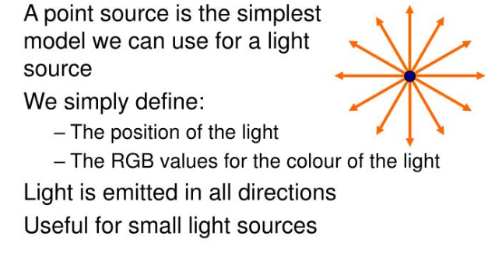

Slide 54
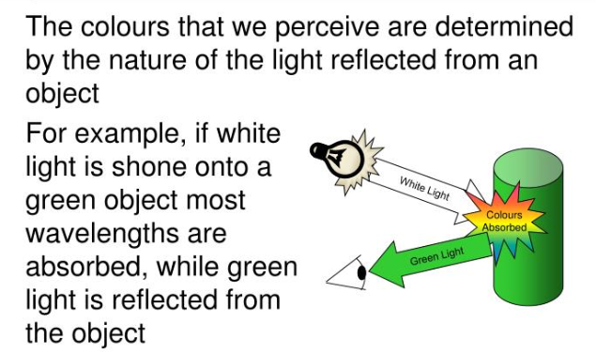

Slide 55
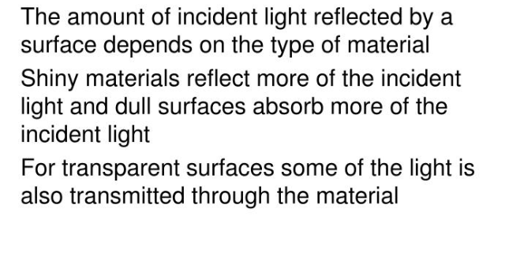

Slide 56
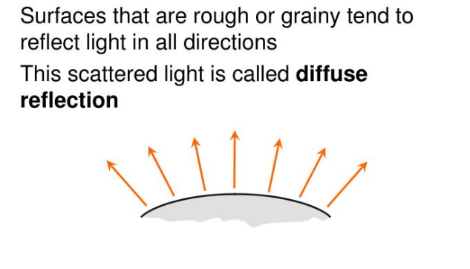

Slide 57
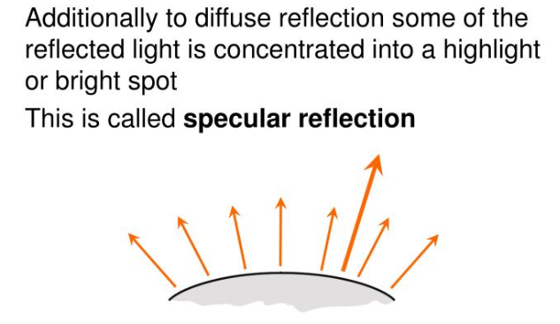

Slide 58
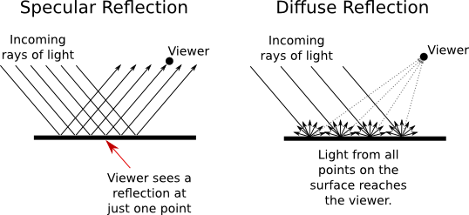

Slide 59
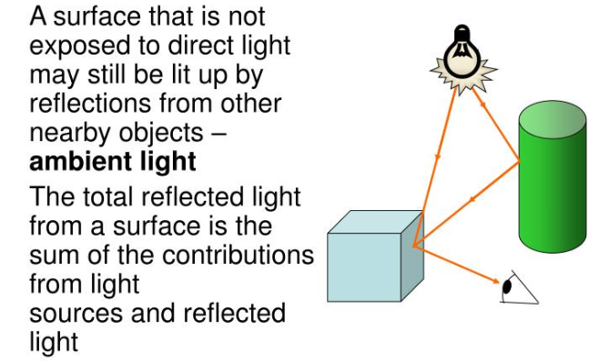
This is a simple way to model the combination of light reflections from various surfaces to produce a uniform illumination called the ambient light, or background light.

Slide 60
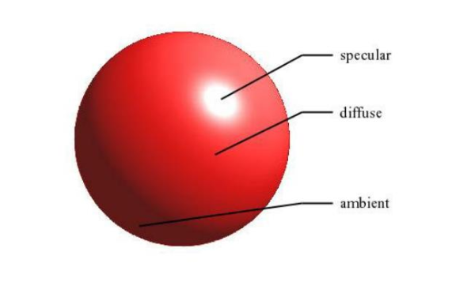

Slide 61
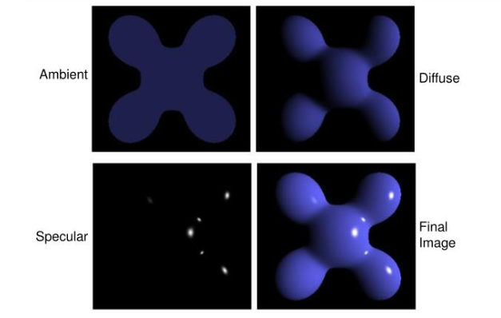

Slide 62
Illumination models:
Illumination models are used to calculate light intensities that we should see at a given point on the surface of an object. Lighting calculations are based on the optical properties of surfaces, the background lighting conditions and the light source specifications. All light sources are considered to be point sources, specified with a co-ordinate position and an intensity value (color). Some illumination models are:
Ambient Light
Diffuse Reflection
Specular Reflection
Nipun Thapa (Computer Graphics)

Slide 63

Illumination Models
Some useful terms:
Normal vector
N
L - light source direction
N - Normal vector
θ −angle of
incidence
L
to light source
θ
N is the surface normal
L is the direction to light source
Vectors N and L are unit vectors
θis the angle of incidence

Slide 64
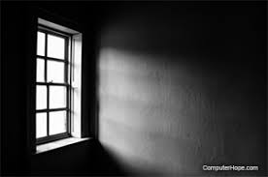
1. Ambient light:
This is a simplest illumination model
We can think of this model, which has no external light source-self-luminous objects. A surface that is not exposed directly to light source still will be visible if nearby objects are illuminated.
The combination of light reflections form various surfaces to produce a uniform illumination is called ambient light or background light.
Also called background light
Ambient light means the light that is already present in a scene, before any additional lighting is added. It usually refers to natural light, either outdoors or coming through windows etc. It can also mean artificial lights such as normal room lights.
Nipun Thapa (Computer Graphics)
11

Slide 65
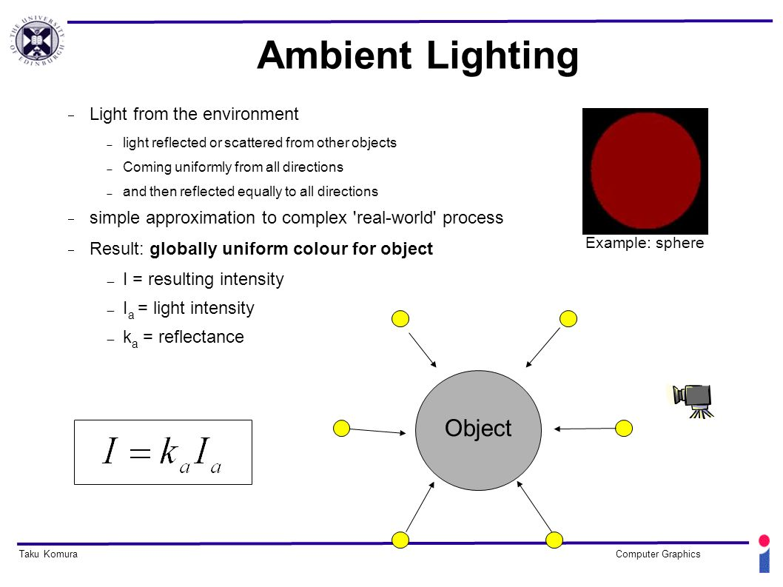

Slide 66


Diffuse Reflection
Diffuse (Lambertian) surfaces are rough or grainy, like clay, soil, fabric
The surface appears equally bright from all viewing directions
The brightness at each point is proportional to cos(θ)
L
N
θ

Slide 67
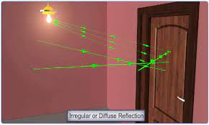
Diffuse reflection

Slide 68
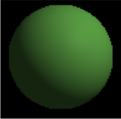

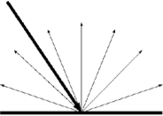
Diffuse (Lambertian) reflection
When light hits an object with a rough surface, it is reflected in all directions
Amount of light hitting the surface depends on the angle between the normal vector and the incident vector of the incoming light.
The larger the angle (up to 90 degrees), the larger the area the incident light is spread over

Slide 69
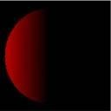
Diffuse reflection
I = I_{a}k_{a} cos θ
I_{a} = Light intensity
Θ = Angle between normal vector and direction to light source
K_{a} = Diffuse reflectivity

Slide 70
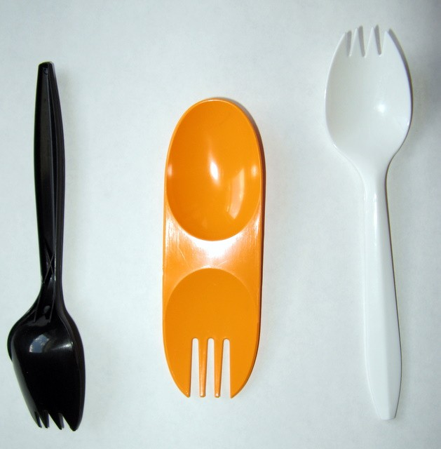
Specular reflection
Direct reflections of the light source off of a shiny surface
Smooth surfaces

Slide 71
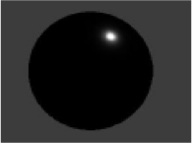

Specular reflection
I = I_{a}k_{a} cos^{n} α
I_{a} Light intensity
α (viewing angle) Angle between reflection vector and direction to camera
k_{a} Specular reflectivity
n Specular intensity
R= unit vector in the direction of ideal specular reflection.
V= unit vector pointing to the viewer from surface position
R
N
L
V
α
p

Slide 72
Polygon rendering / surface shading
Two ways of polygon surface rendering:
Single intensity for all points in a polygon
Interpolation of intensities for each point in a polygon
Methods:
Flat Shading(Constant Intensity Shading)
Gouraud Shading
Phong Shading
Nipun Thapa (Computer Graphics)
38

Slide 73
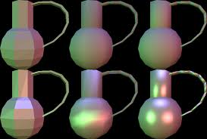
44
Nipun Thapa (Computer Graphics)

Slide 74
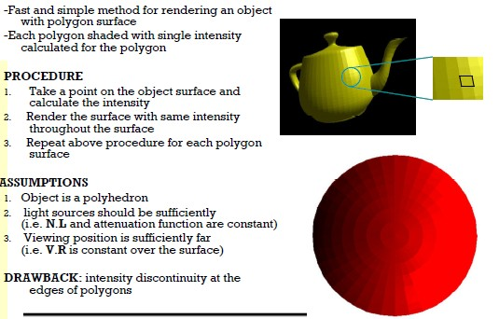
1. Constant Intensity Shading (Flat)
Nipun Thapa (Computer Graphics)

Slide 75
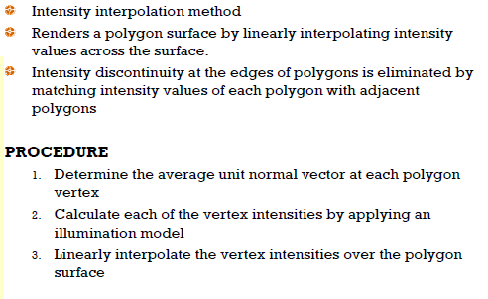
2. Gouraud Shading
Nipun Thapa (Computer Graphics)

Slide 76
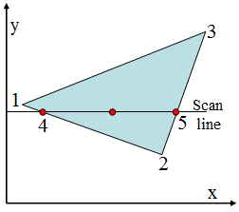
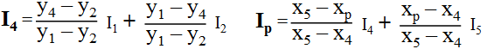
2. Gouraud Shading…..
For Gouraud shading, the intensity at point 4 is linearly interpolated from the intensities at vertices 1 and 2.
The intensity at point 5 is linearly interpolated from intensities at vertices 2 and 3.
An interior point p is then assigned an intensity value that is linearly interpolated from intensities at positions 4 and 5.
p
Nipun Thapa (Computer Graphics)

Slide 77
2. Gouraud Shading…..
Advantages:
Removes discontinuities of intensity compared to constant shading model
at the edge
Nipun Thapa (Computer Graphics)
Limitations:
Highlights on the surface are sometimes displayed with anomalous(irregular) shapes and linear intensity interpolation can cause bright or dark intensity streaks, called Mach Bands to appear on the surfaces. Mach bands can be reduced by dividing the surface into a greater number of polygon faces or Phong shading (requires more calculation).
42

Slide 78
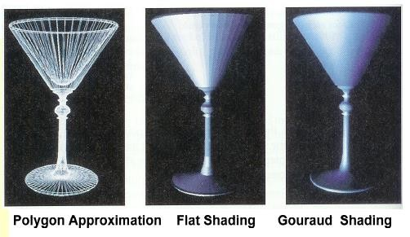

Surface Rendering
Nipun Thapa (Computer Graphics)
43

Slide 79
3.Phong Shading
A more accurate method for rendering a polygon surface is Phong shading, or normal vector interpolation shading which first interpolate normal vectors, and then apply the illumination model to each surface point. It displays more realistic highlights on a surface and greatly reduces the Mach- band effect.
Nipun Thapa (Computer Graphics)
45

Slide 80
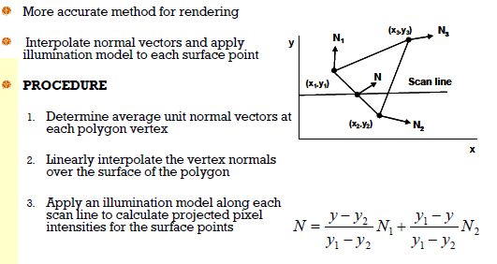
3.Phong Shading
Nipun Thapa (Computer Graphics)

Slide 81
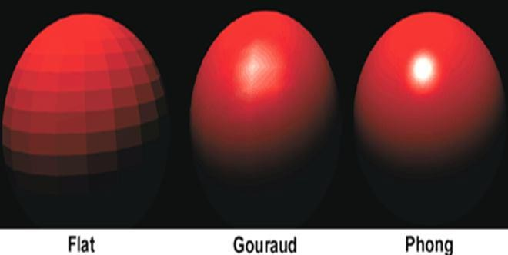
Gouraud Vs Phong Shading
Gouraud shading is faster than Phong shading
Phong shading is more accurate
Nipun Thapa (Computer Graphics)

Slide 82
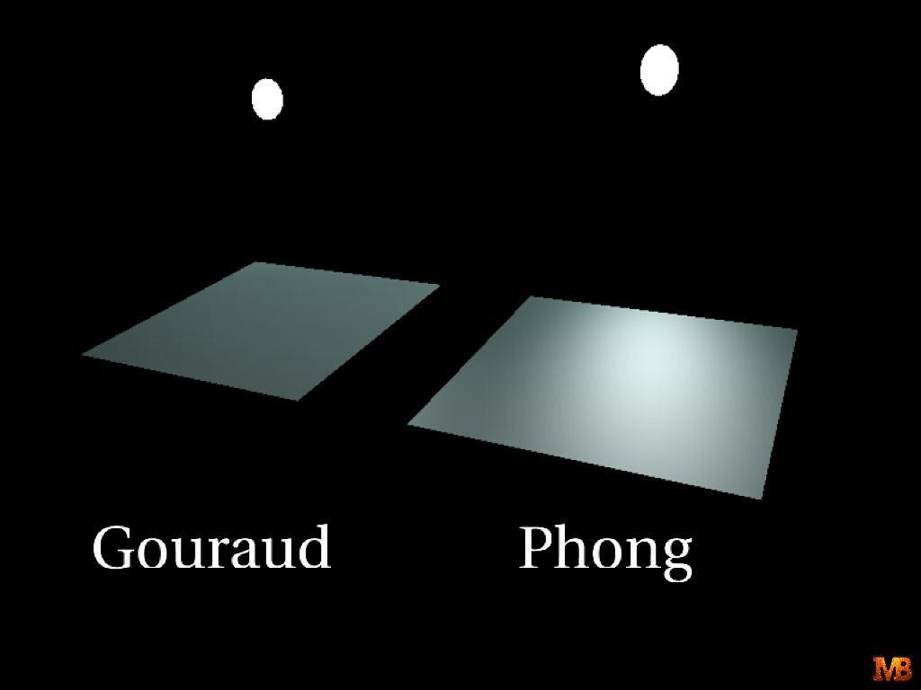
Gouraud Vs Phong Shading
Nipun Thapa (Computer Graphics)

Slide 83

Ray tracing

Slide 84


Slide 85


Slide 86


Slide 87


Slide 88

Finally the color of the object is noted down from the presence of the light

Slide 89


Slide 90
Unit 4
Curve Generation, Bezier and B-spline Methods. Basic Illumination Model: Diffuse Reflection, Specular Reflection, Phong Shading, Gouraud Shading, Ray Tracing, Color Models like RGB, YIQ, CMY, HSV.

Slide 91


Slide 92

A Color model is a method for explaining the properties or behavior of the color with in some particular context.

Slide 93


Slide 94

Low frequency
High frequency

Slide 95

Intensity of light)

Slide 96


Slide 97


Slide 98


Slide 99


Slide 100


(0,1,1)
(1,0,1)
(1,1,0)

Slide 101

(0,1,1)
(1,0,1)
(1,1,0)

Slide 102


Slide 103


Slide 104



Slide 105


Slide 106


Slide 107


Slide 108


Slide 109


Slide 110


Slide 111


Slide 112


Slide 113
THANK YOU

